Slide 1
2021 GPE AWARDS
Awards Committee:
Omar Poma Gil - USIL
Brian Patton - UC
Aaron Smith – UT
Melanie Robbins - ECU
14th Annual GPE Conference | May 17-19, 2021

Slide 2
Recognizing 10+ Years of Partnership
10 Years
Fatima Jinnah Women University - Pakistan
HAN University of Applied Sciences - Netherlands
Carpathian State College - Poland
MATS University - India
Modern University for Business and Science - Lebanon
St. Aloysius College - India
Universidad de Monterrey - Mexico
Ural State Pedagogical University - Russia
11 Years
Baotou Teachers College - China
Ryukoku University - Japan
12 Years
University American College Skopje - North Macedonia
University of Shimane - Japan
13 Years
Universidad ESAN - Peru
14 Years
Universidad Regiomontana - Mexico
15 Years
Fu Jen Catholic University - Taiwan
16 Years
Université Aboubekr Belkaid, Tlemcen - Algeria
University of Jammu - India
Universidad San Ignacio de Loyola - Peru
17 Years
University of the Gambia - The Gambia
Shaanxi Normal University - China
14th Annual GPE Conference | May 17-19, 2021

Slide 3
Rosina C. Chia Award For Excellence in Teaching
Nominees
Benameur Nehar, UABT (Algeria) | Roberto René Báez Fuentes, UR (Mexico) | Jihane Ben Massoud, ESTE (Morocco) | Nicolas de la Peña, LSC (Colombia)
Kerri Mackenzie , UT (France) | Manal Zeineddine, MUBS (Lebanon) | Amal Abou Shakra, MUBS (Lebanon) | Anna Łobodzińska, CSC (Poland)
Stella R. Tippin de Malpica, ESAN (Peru) | Ivana Trajanoska, UACS (Macedonia) | Cristian Yepes, LSC (Colombia) | Lulio Cardenas, USIL (Peru)
Zeynep Bilgehan, FSM (Turkey) | Jason Humphreys, HHN (Germany) | Tope Adeyemi-Bello, ECU (USA) | Hernando Pinto , USIL (Peru)
Yanhong Zong, BCBUU (China) | Amine Belaid, UABT (Algeria) | Jesus McMitre, UR (Mexico) | Jennifer Sisk, ECU (USA)
Nadia Bakhtawer, FJWU (Pakistan) | Jacob Petersen-Perlman, ECU (USA) | Eben Proos, CUT (South Africa) | Mariko Eguchi, USJ (Japan)
Katarzyna Dziemian, CSC (Poland) | Marion Eppler, ECU (USA) | Irene Snelleman, HAN (Netherlands) | Sarah Page, ECU (USA)
Rocio Knipp, UM (Chile) | Olga Alifanova, USPU (Russia) | Ivan Kruhlov, LNU (Ukraine) | Blakely Brooks, ECU (USA)
Berenice Sánchez, UDEM (Mexico) | Danny Capellan, UNIBE (Dominican Republic) | Shahla Tabassum, FJWU (Pakistan) | Li Deng, CUPL (China)
Ekaterina Rogova, USPU (Russia) | Luis Vargas, UNLA (Mexico) | Lucile Groleau, UT (France)
Eko Pam, AUECU (Australia) | Cynthia Deale, ECU (USA) | The team of Charlotte Leforestier and Adel-Malik Ola, UT (France)
14th Annual GPE Conference | May 17-19, 2021
Highlighted individuals are finalists

Slide 4
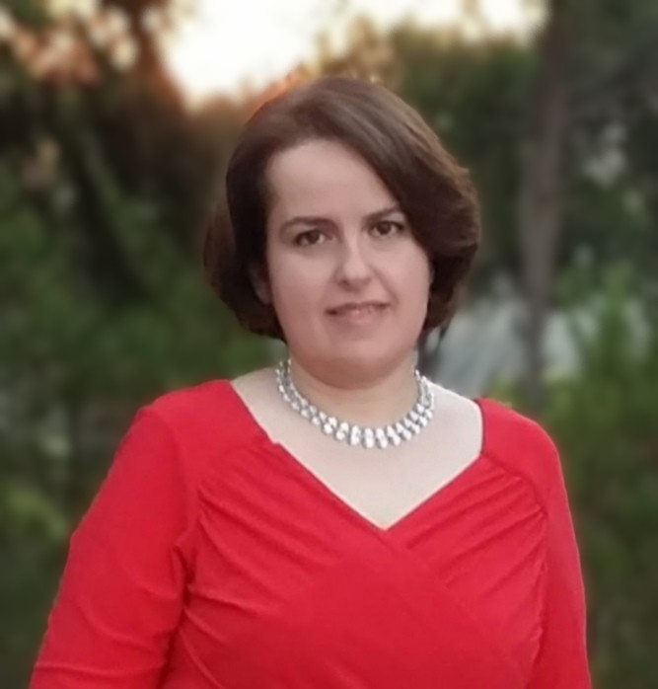
Rosina C. Chia Award For Excellence in Teaching
Finalists
Anna Łobodzińska (CSC, Poland) - Anna is one of the best partners I've worked with. She is cooperative and flexible, professional and funny. Through her enthusiasm, prompting, and sense of humor, she helped making our links lively and successful.
Blakely Brooks (ECU, USA) - Blakely has mastered how to approach and work a friendly and educational intercultural experience. He is keen in a two way process of achieving GU objectives.
14th Annual GPE Conference | May 17-19, 2021
Amal Abou Shakra (MUBS, Lebanon) - Amal prepared her students well for this class and was guiding them and our discussions went smoothly and students were eager to continue discussions after our classes.

Slide 5
Rosina C. Chia Award For Excellence in Teaching
Finalists
Anna Łobodzińska (CSC, Poland) - Anna is one of the best partners I've worked with. She is cooperative and flexible, professional and funny. Through her enthusiasm, prompting, and sense of humor, she helped making our links lively and successful.
Blakely Brooks (ECU, USA) - Blakely has mastered how to approach and work a friendly and educational intercultural experience. He is keen in a two way process of achieving GU objectives.
14th Annual GPE Conference | May 17-19, 2021
Amal Abou Shakra (MUBS, Lebanon) - Amal prepared her students well for this class and was guiding them and our discussions went smoothly and students were eager to continue discussions after our classes.

Slide 6
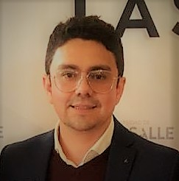
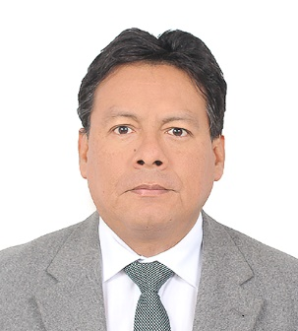
Rosina C. Chia Award For Excellence in Teaching
Finalists
Cristian Yepes (LSC, Colombia) - Cristian communicates in a highly effective, timely manner with his students and with my students during the video and provides thoughtful feedback.
Jennifer Sisk (ECU, USA) - Jenn is hard worker, a gentle soul and a devoted person. She is one of those teachers who seems to live the classes she teaches.
14th Annual GPE Conference | May 17-19, 2021
Hernando Pinto (USIL, Peru) - Hernando is a wonderful Professor. His students showed him respect and you could tell that they enjoyed his class. We were able to have some fun banter at the start of class, yet when it was time to focus on our days topic, the students jumped in to ask questions. Hernando was a great mix of personal and professional.

Slide 7
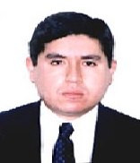
Rosina C. Chia Award For Excellence in Teaching
Finalists
Jihane Ben Massoud (ESTE, Morocco) - Jihane is well-organized, a great communicator, and facilitates the discussion well. She is also very respectful of her students.
Mariko Eguchi (USJ, Japan) - Mariko is an excellent collaborator for multicultural communication and learning. She is also very keen in assisting partner teacher in collaborating to achieve GU´s objectives.
14th Annual GPE Conference | May 17-19, 2021
Lulio Cardenas (USIL, Peru) - I think Lulio deserves to be rewarded for his efforts because he proves to have been probably the easiest-going and best organized partner I have ever had teaching the GU.
Sarah Page (ECU, USA) - It is always a pleasure to work with Sarah. She is an excellent communicator, always has a positive attitude, and is great at facilitating discussions during links.

Slide 9
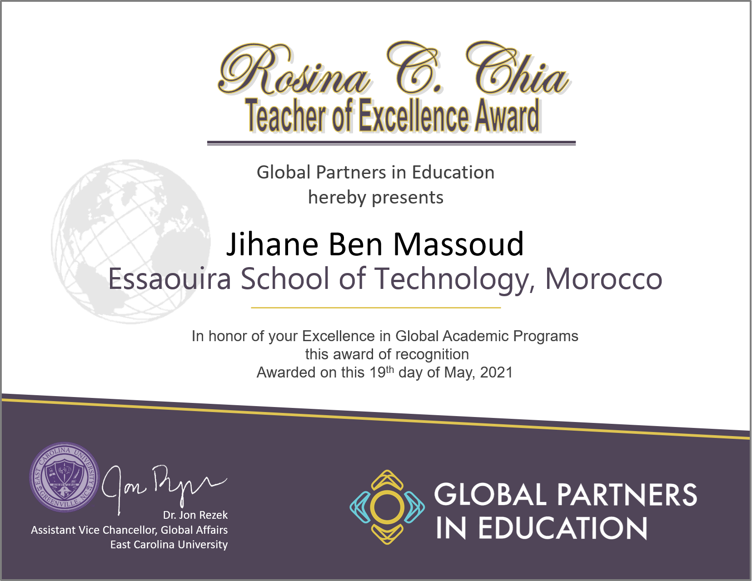
14th Annual GPE Conference | May 17-19, 2021

Slide 11
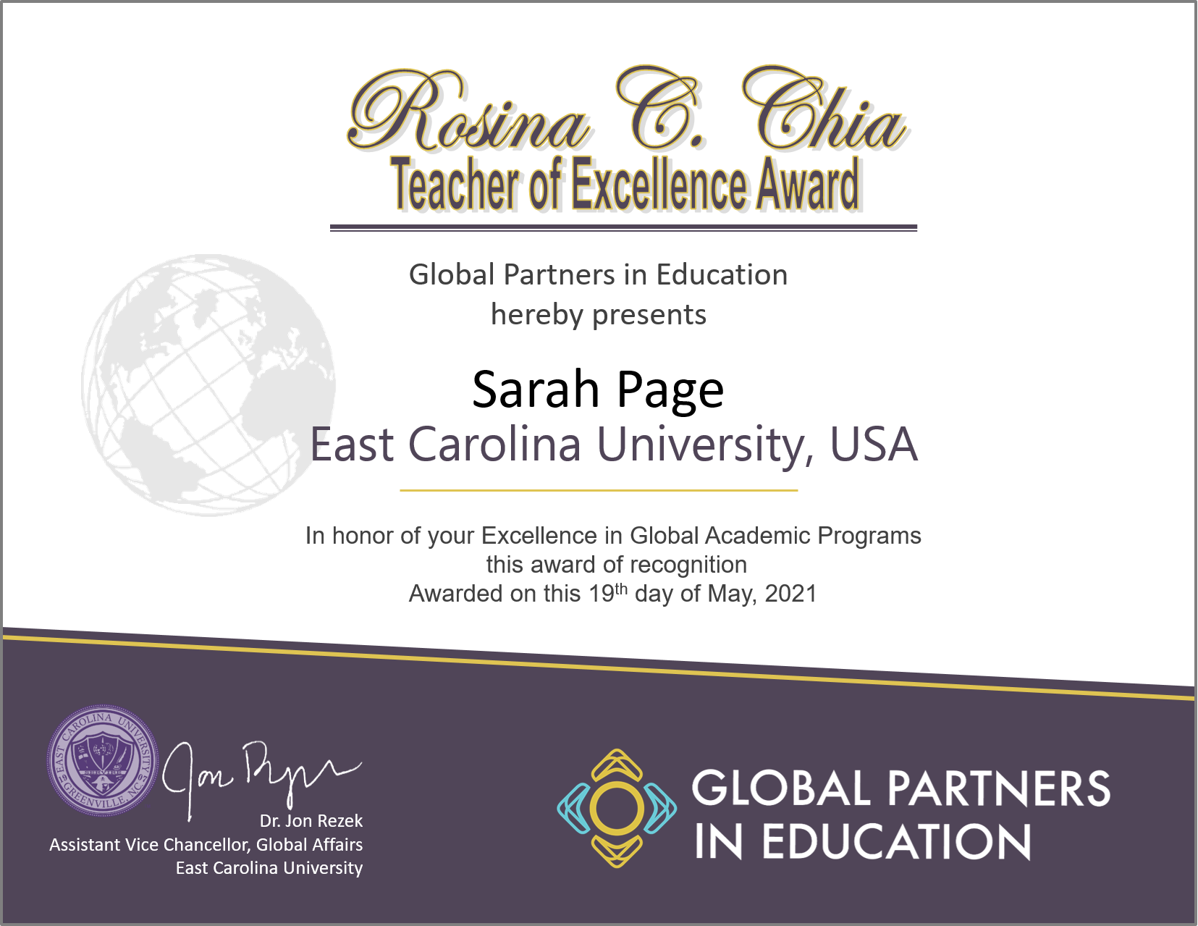
14th Annual GPE Conference | May 17-19, 2021

Slide 12
14th Annual GPE Conference | May 17-19, 2021

Slide 13
Meng Fanxi Award For Institutional Excellence
Past Recipients
2020 University of Tours, France
2019 Modern University for Business and Science, Lebanon
2018 Universidad de Monterrey, Mexico
2017 Ural State Pedagogical University, Russia
2016 University of Shimane, Japan
Krosno State College, Poland
Universidad San Ignacio de Loyola, Peru
2013 Universidad Regiomontana, Mexico
2012 Lomonosov Moscow State, Russia
2011 Shandong University, China
14th Annual GPE Conference | May 17-19, 2021

Slide 15
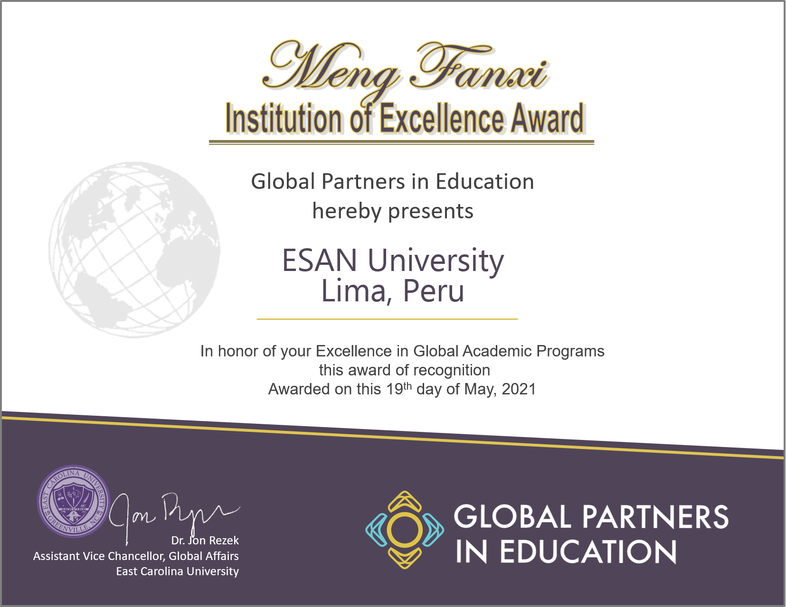
14th Annual GPE Conference | May 17-19, 2021

Slide 16
Congratulations to all the nominees and recipients. We appreciate the work you do and know that the quality you bring to your participation makes this program strong and contributes to the positive experiences of all our students and partners.
14th Annual GPE Conference | May 17-19, 2021

